Slide 1

World Building in
Open 3D Engine
Jonny Galloway, AWS
@hogjonny

Slide 2

Who am i?
Tech Art for Realtime 3D
Content Tools And Workflows
Env Art and Lighting
Procedural World Building
Jonny Galloway Sr. Design Technologist
@hogjonny (everywhere)
To get to the top of a mountain, it takes many small steps …
Or build a helicopter.

Slide 3
Who are You?
Skill Level: Intermediate
Hobbyist, Indie or AAA Game Dev
Level Designers
Environment Artists
Someone who likes procedural design toolkits

Slide 4
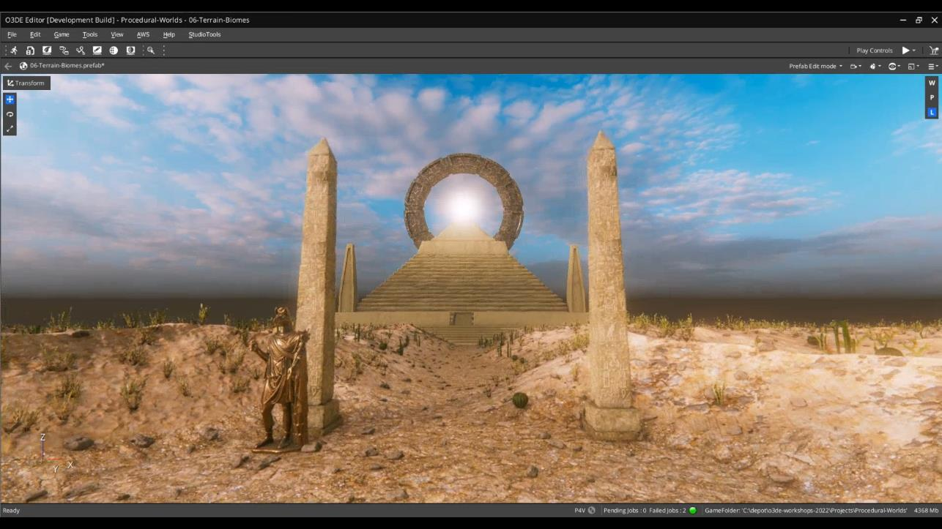

Slide 5
Core Concepts and Understanding
I’d like you to walk away with …
Zero to Beautiful Accelerated ( Work Faster )
Executing Quality at Scale ( Work Bigger )
Procedural Design: Landscapes, Terrain, Biomes
HDR Environmental Lighting and Post FX
Open 3D Engine can make beautiful worlds
It is still early ( there is engine work left to do)

Slide 6
Worlds need content
Open 3D Engine … yes, I am plugging our tools
3D Models, PBR Materials and texture maps
HDRi / IBL, skybox and lighting resources
3D Digital Content Creation tools
Image Editors, and Material Authoring tools
Terrain data like heightfields, and color maps
Terrain Editors

Slide 7
Freely available content resources
3D Models
Sketchfab (and there are many others)
PBR Materials
Top 7 websites (link)
HDRi “image Based Lighting” aka Skybox / Skylight
Polyhaven.com/hdris

Slide 8
Content Creation Tools
Autodesk Maya is my 3D DCC tool of choice
Blender is a free alternative
Adobe Photoshop for image editing
Krita is a free alternative
PBR: Adobe Substance Designer, Sampler, Painter
Material Maker is a free alternative
Terrain: Quad-spinner Gaea

Slide 9
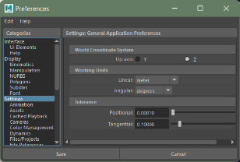
Autodesk Maya, settings for 3D content
Settings:
Scene Units: Meters
Coordinate System: Z-up
Preferred format: FBX
Maya menu >
Windows > Settings/Preferences > Preferences

Slide 10
1. Getting Started
Creating a project and our first level

Slide 11
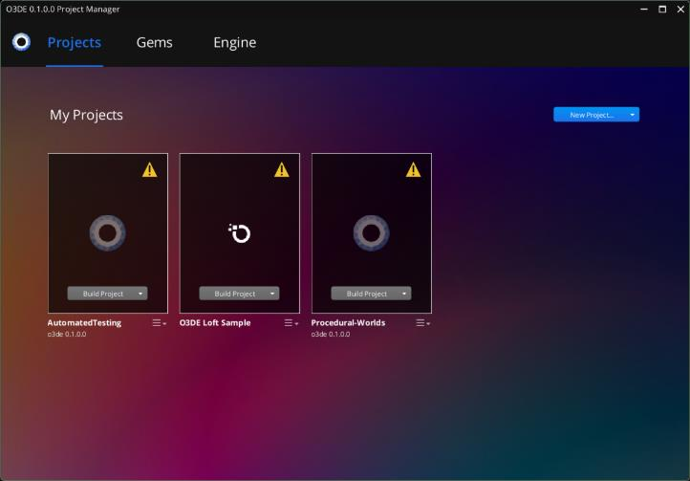
Create a New Project
Open O3DE
Create Project
Enable Gems
Landscape Canvas
FastNoise
Vegetation
Terrain
Build Project
Launch Editor

Slide 12
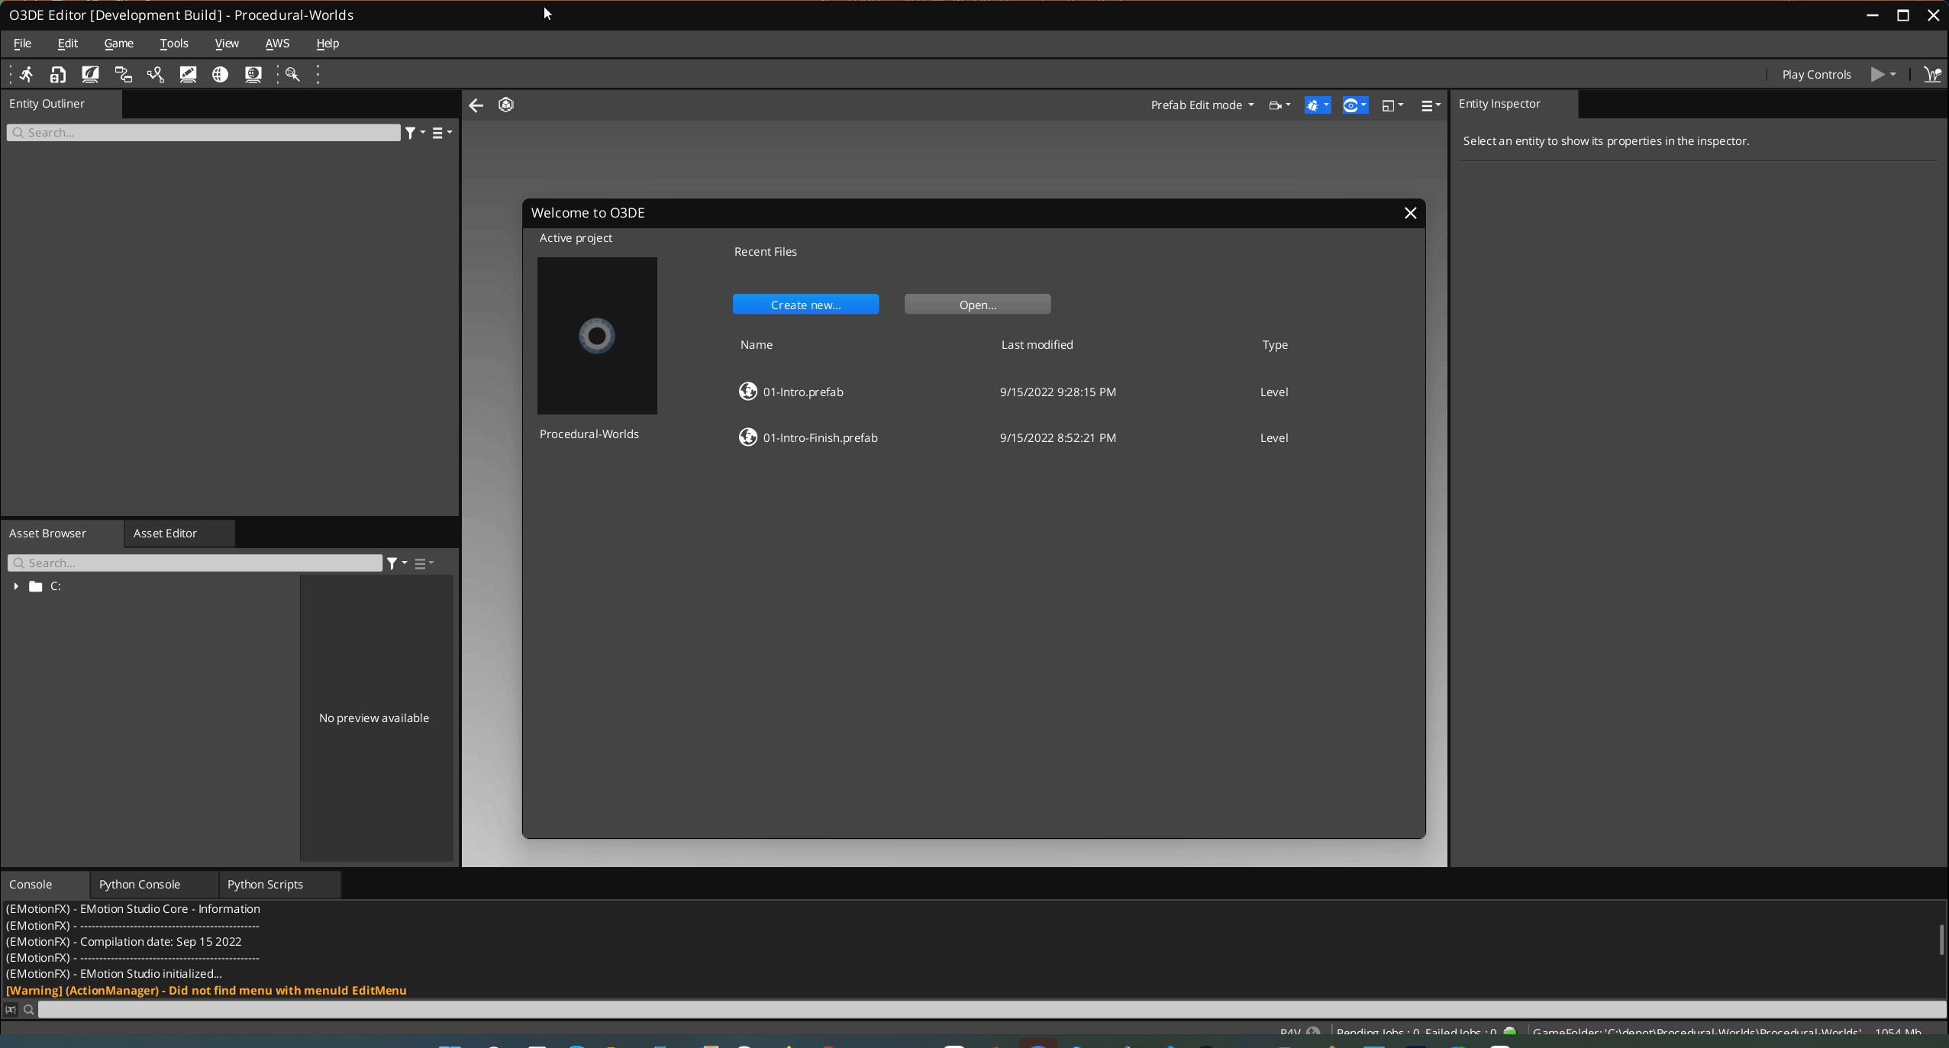
Create a New Level

Slide 13
2. Global Lighting
Let there be Light…

Slide 14
Realistic worlds need realistic lighting
Static, HDR, Image Based Lighting (IBL)
Direct Lighting and Shadows
HDRi Source (latlong .EXR)
Multiple Output Cubemaps:
Skybox
Specular Reflections
Indirect Diffuse
Freely available, HDRi IBL images under Creative Commons Zero license (CC0)
https://polyhaven.com/a/goegap
https://polyhaven.com/license

Slide 15
HDRi, IBL Naming Conventions
< img >_SkyboxCM
Generates:
Only Skybox Cube:
_skyboxcm
< img >_IBLglobalCM
Generates:
Lighing Cubemaps:
_ibldiffuse
_iblspecular
< img >_IBLskyboxCM
Generates:
All Cubemaps:
_ibldiffuse
_iblspecular
_skyboxcm

Slide 16
High Contrast HDRi
Example: O3DE\Gems\Atom\Feature\Common\Assets\LightingPresets\HighContrast
Input Image: < HDRi >_SkyboxCM.exr
Generates Output Assets:
1. < HDRi >_skyboxcm.exr.streamingimage
Sun painted out
Input Image: < HDRi >_IBLglobalCM.exr
Generates Output Assets:
1. < HDRi >_iblglobalcm_iblspecular.exr.stream…
2. < HDRi >_iblglobalcm_ibldiffuse.exr.stream…

Slide 17
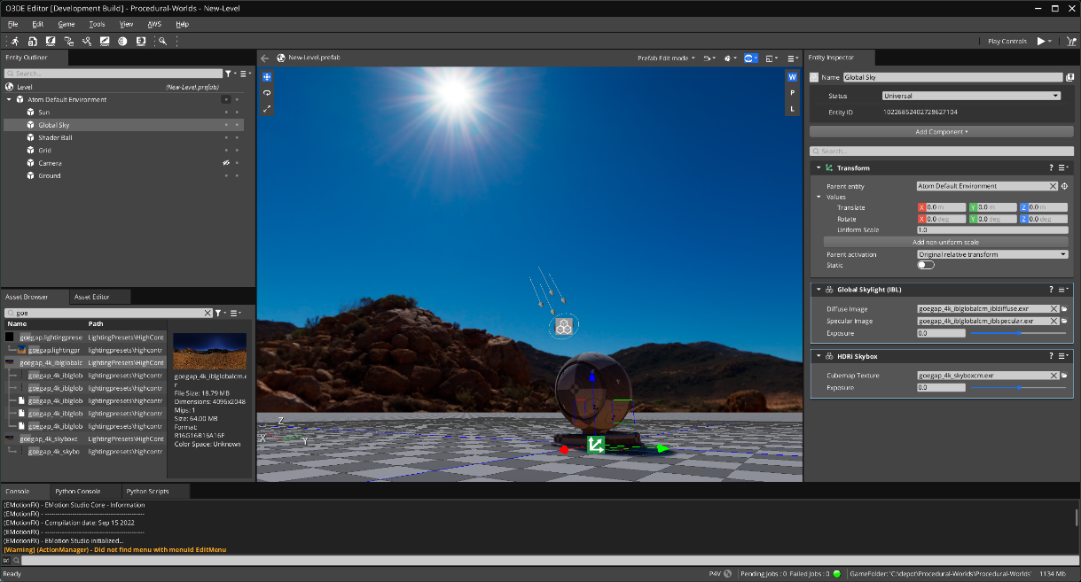
Anatomy of Default Level Lighting
Output Asset:
< HDRi >_skyboxcm.exr.streamingimage

Slide 18
Anatomy of Default Level Lighting
Output Asset:
< HDRi >_specularcm.exr.streamingimage
Sun painted out

Slide 19
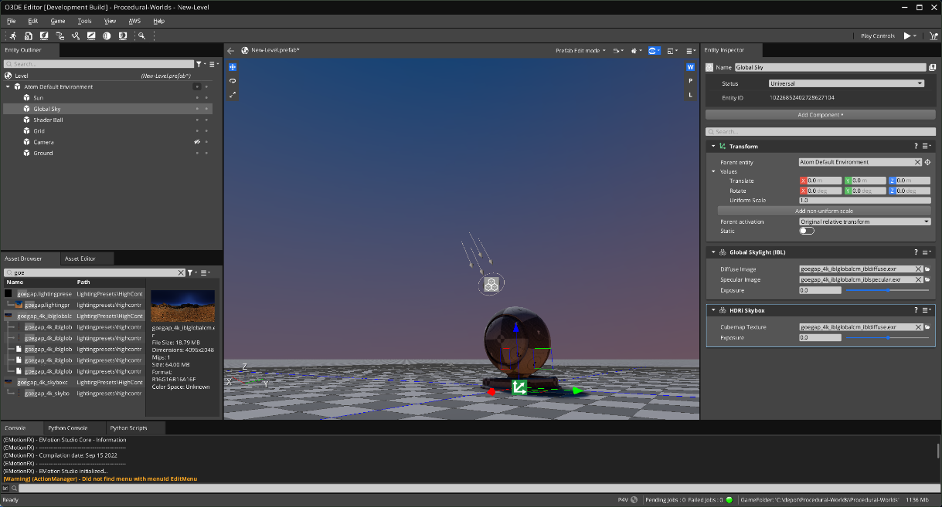
Anatomy of Default Level Lighting
Output Asset:
< HDRi >_diffusecm.exr.streamingimage

Slide 20
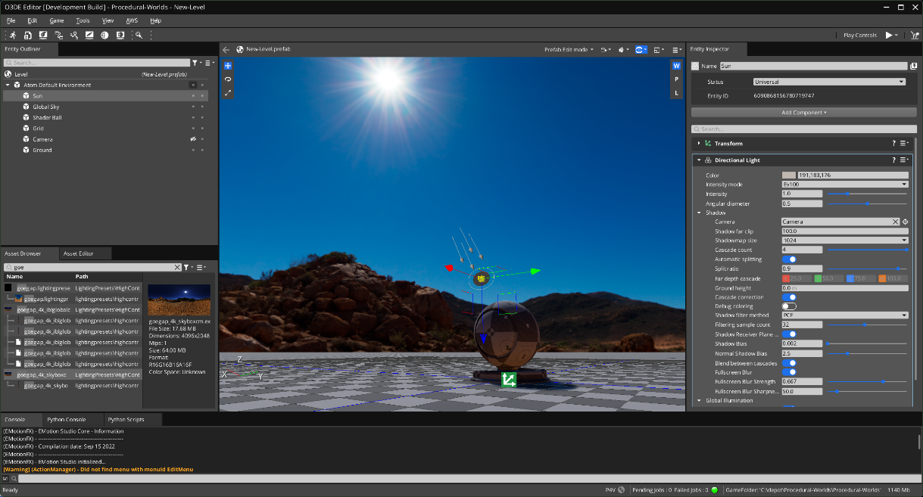
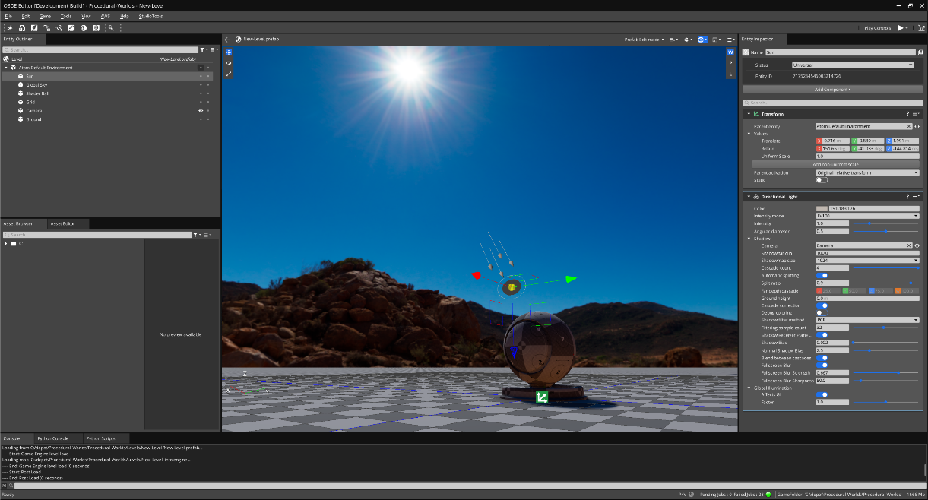
Anatomy of Default Level Lighting
Directional Light (Sun)
Adds Sun Energy
(was painted out of lighting cubemaps)
Adds Cascade Shadows

Slide 21
3. Customize Level
Lighting, materials and PostFX

Slide 22
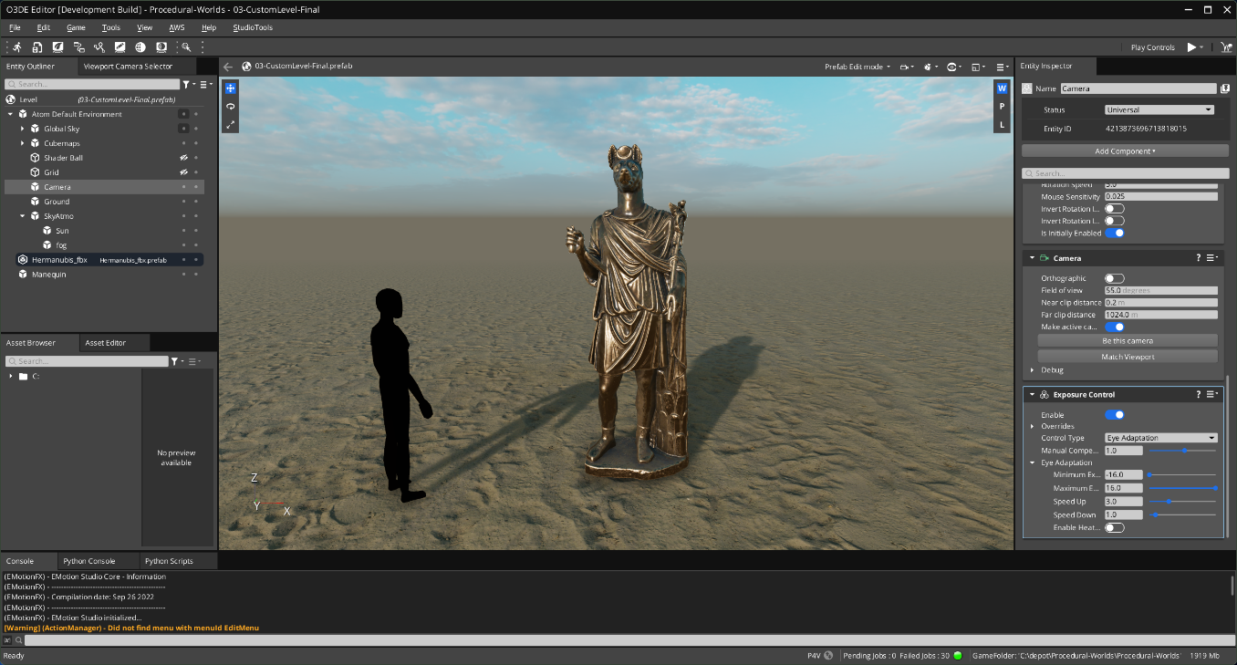

Slide 23
Customize the default level
Create a PBR material, assign to the ground
Replace the Skybox and Global Lighting
Enable Sky Atmosphere and Fog
Replace the Shaderball with a Statue model
Mesh Component, load FBX
Material Component, assign Material

Slide 24
PBR Materials
Base PBR
Metal / Rough shading model
Standard PBR
Adds Emissive and Clearcoat
Adds Displacement (parallax)
Enhanced PBR
Adds Detail Layer
Adds Transmission (thick and thin surface)
Adds SubSurface Scattering (SSS)

Slide 25
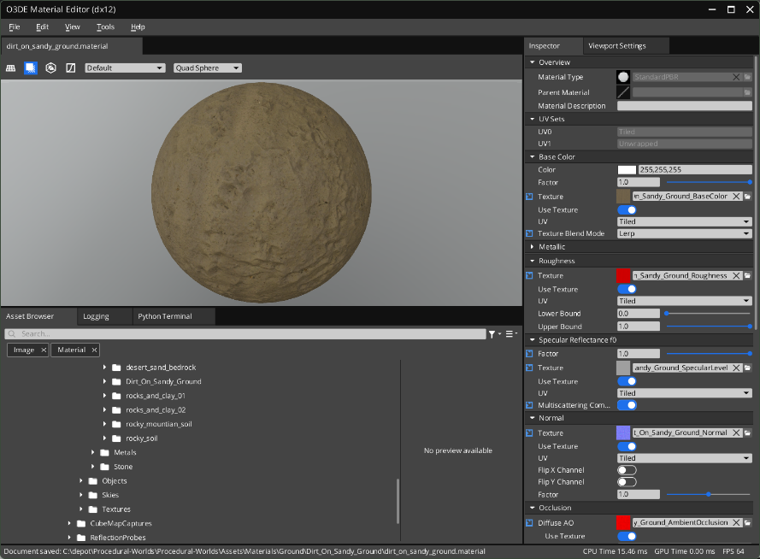
Material Editor

Slide 26
Adjust Global Lighting
Change the Skybox, SkyLight, Fog, Sky Atmosphere
Create Entities with Cubemap Capture Components,
GlobalSpecular, GlobalDiffuse, and Bake
Duplicate GlobalSkyLight Entity,
Replace with captured cubemaps
Create Reflection Probe Entity and Bake

Slide 27
Customize Level
LIVE DEMO … Let’s do this

Slide 28
4. PostFX Default Look
Adding some visual pizazz

Slide 29
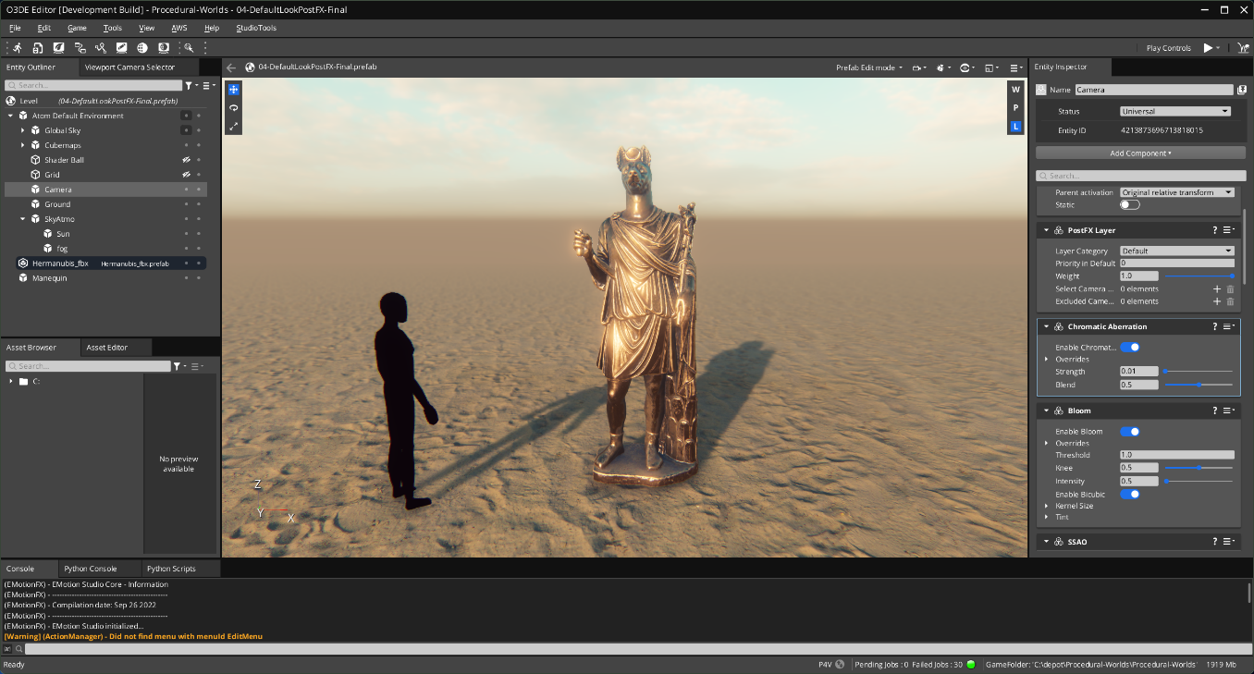

Slide 30
Customize the default level (live demo)
Add PostFX Layer Component to Camera
Add Exposure Control Component
Add SSAO Component
Add Depth of Field Component
Add Bloom Component
Add Chromatic Aberration Component
Add HDR Color Grading Component

Slide 31
Post FX, Default Look
LIVE DEMO … Let’s do this

Slide 32
5. Building Blocks
Core Concepts: Let’s Get Procedural

Slide 33
“Procedural modeling is an umbrella term for a number of techniques in computer graphics to create 3D models and textures from sets of rules. L-Systems, fractals, and generative modeling are procedural modeling techniques since they apply algorithms for producing scenes..”

Slide 34
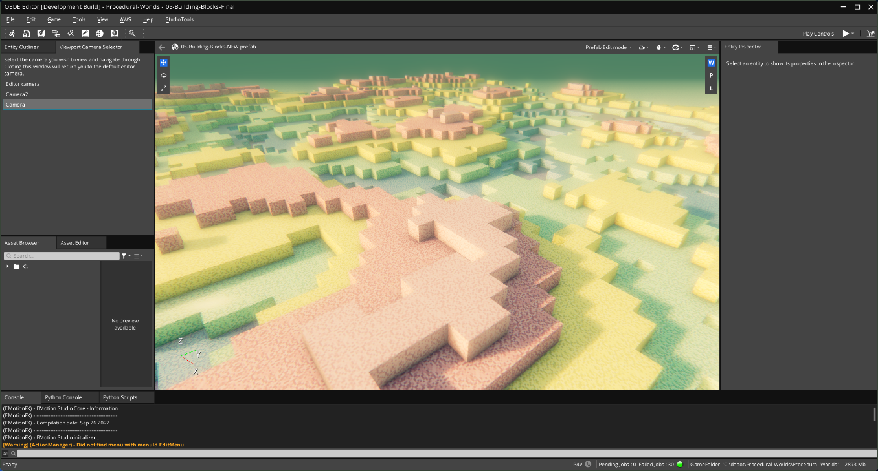

Slide 35
Create Color Block Prefabs
Create several materials of varied color
Create Entity and Add Mesh Component
Load the Block_1m FBX asset
Add the Material Component, load first material
Duplicate block entity 5 more times
Change the material assignment on each
Save each as a prefab

Slide 36
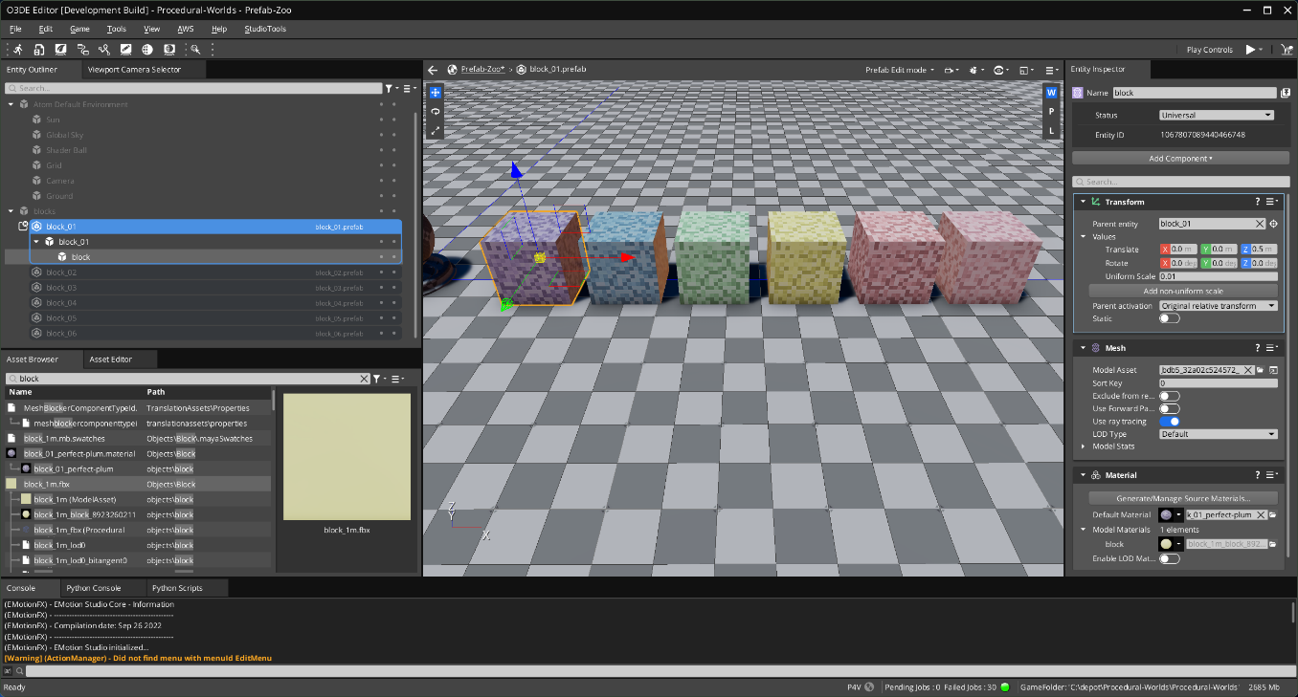

Slide 37
About Dynamic Vegetation
Let’s abuse Dynamic Vegetation
Gradient Signals ( procedural noise, images, etc.)
Semantic World Design ( surface data tags )
Landscape Canvas ( world graph, signal composition )
Decorative Object Placement System
E.g. Spawns Prefabs

Slide 38
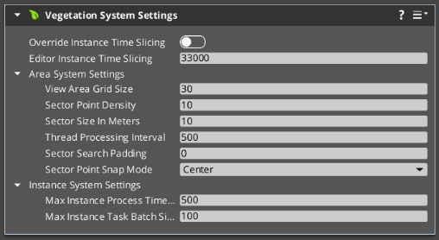
Create Building Blocks World
New Level: ‘Save as …’ My-Block-World
Select the Level Entity
Add Vegetation System Settings Component
View Area Grid Size = 30
Sector Point Density = 10
Sector Size in Meters = 10
Sector Point Snap Mode = Center

Slide 39
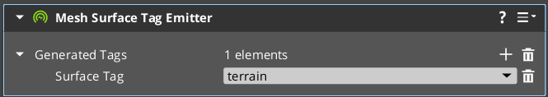
Set up World Data
Dyn Veg wants to plant on Terrain
Select the Ground entity
Add Mesh Surface Tag Emitter
Press the + to add a tag
Set tag pulldown to = terrain

Slide 40
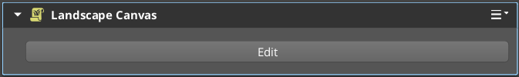
Set up Landscape Canvas ( Live Demo )
Landscape Canvas is a Visual Graph Tool
For Procedural Terrain, Vegetation, Landscaping
Create an Entity named BuildingBlocks
Add the Landscape Canvas Component

Slide 41
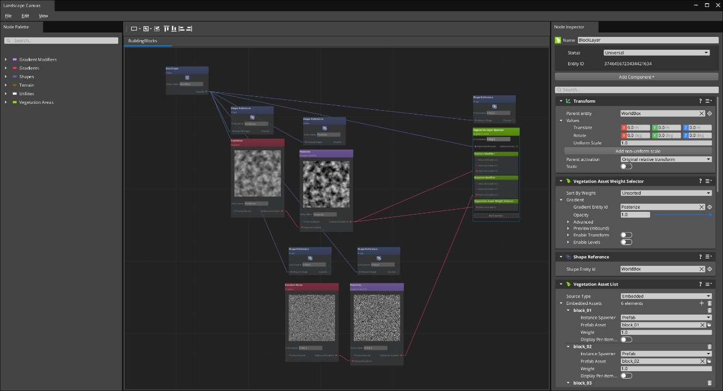

Slide 42
Building Blocks
LIVE DEMO … Let’s do this

Slide 43
6. Terrain Basics
Core Concepts: Let’s Get Procedural

Slide 44
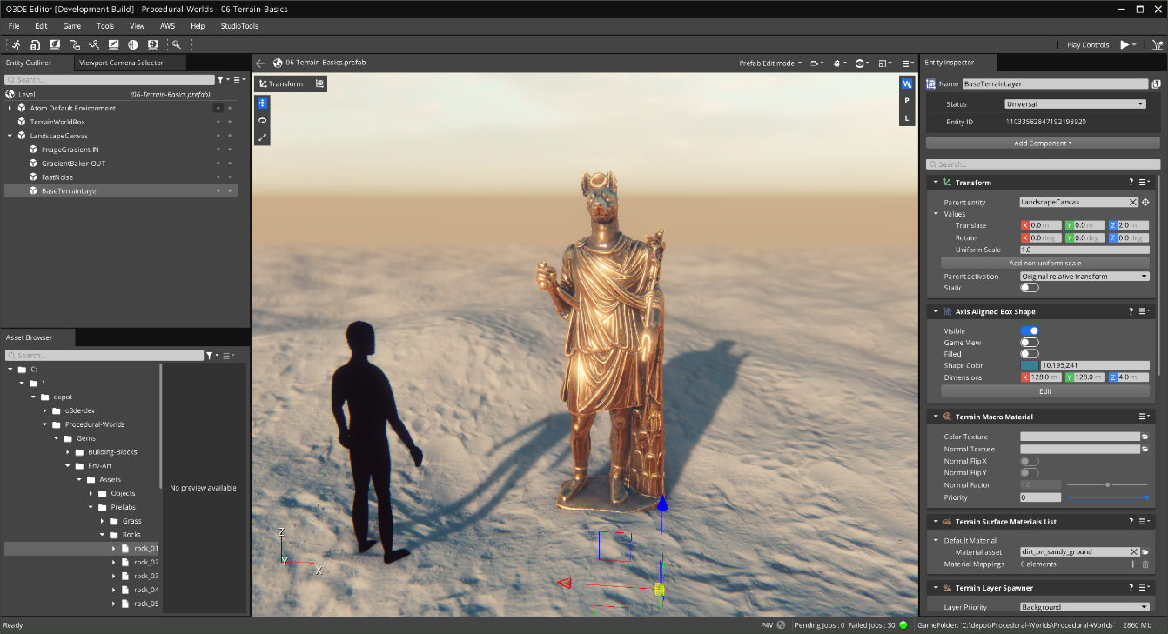
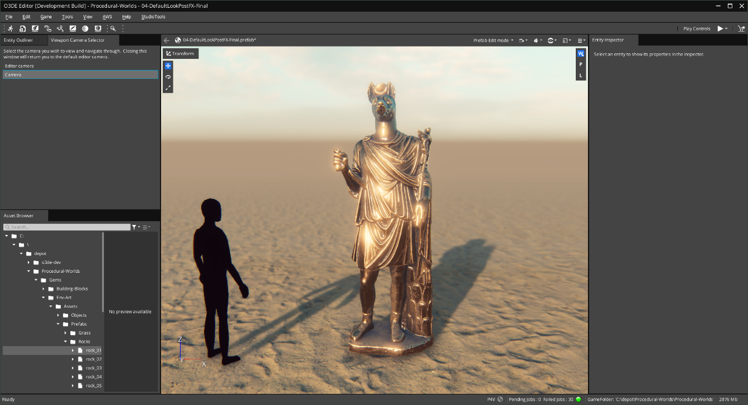

Slide 45
Simple Terrain
Level Entity: Terrain System Components
Set up Terrain World Box
Set up Landscape Canvas
Set up Fast Noise ( bumpy procedural noise )
Set up Terrain Layer ( heightfield )
Assign Terrain Material

Slide 46
Terrain Basics
LIVE DEMO … Let’s do this

Slide 47
6B. Macro Color
Concept: External Data

Slide 48
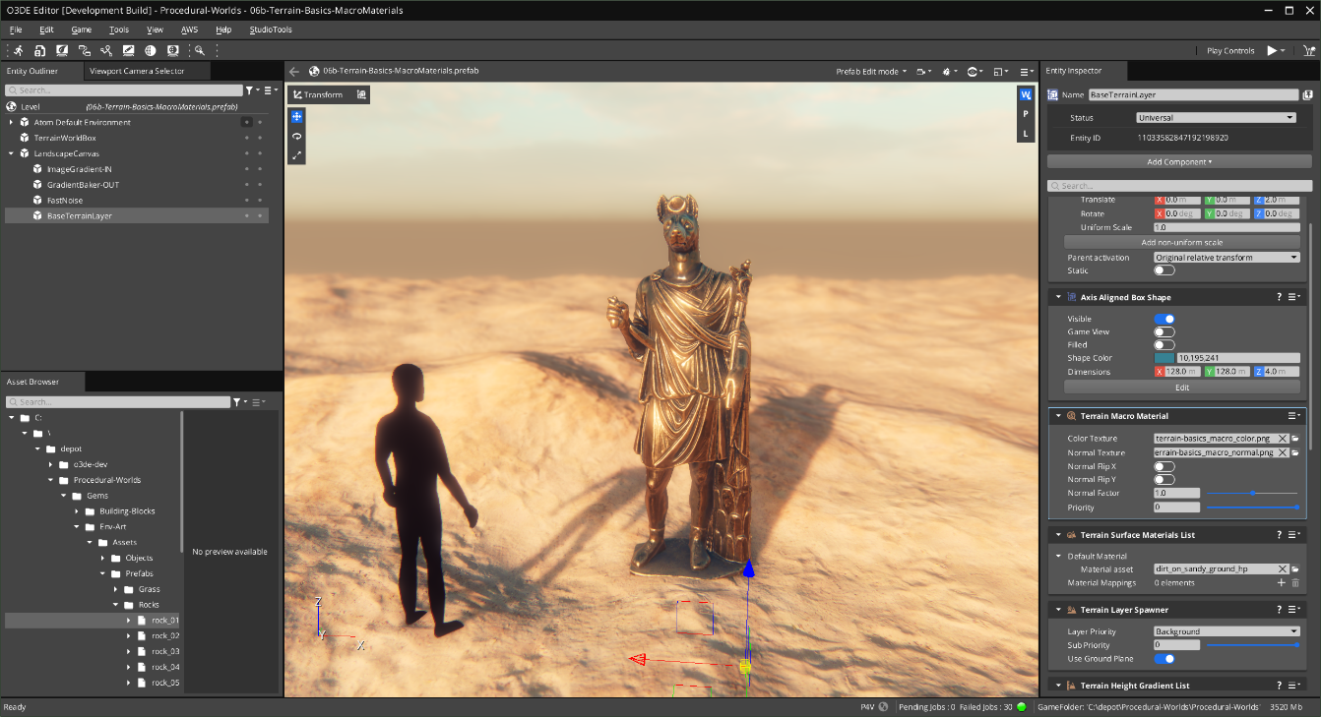

Slide 49
Terrain Macro Material
Bake heightmap out with Gradient Baker
Take heightmap into Terrain DCC tool
I used Quadspinner Gaea
Generate new Terrain outputs …
Macro Color, Normal and some Splatmaps

Slide 50
Terrain Macro Color
LIVE DEMO … Let’s do this

Slide 51
6C. Detail Blending
Concept: Blending Materials

Slide 52
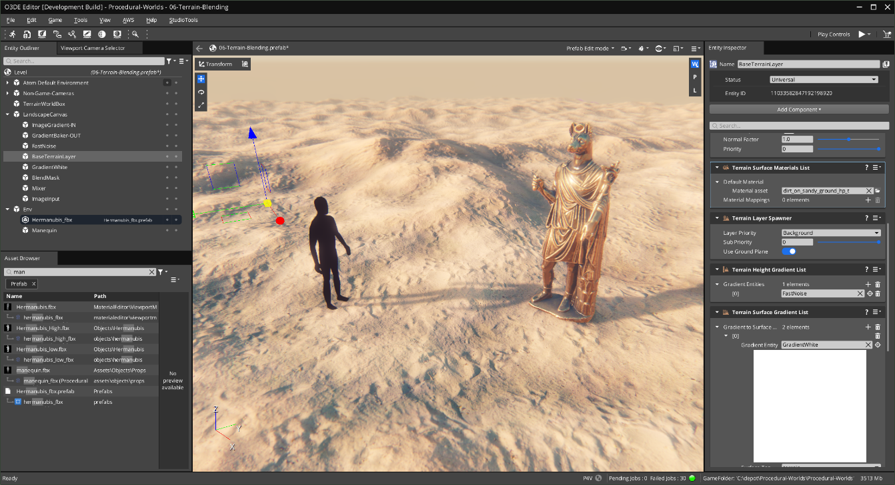
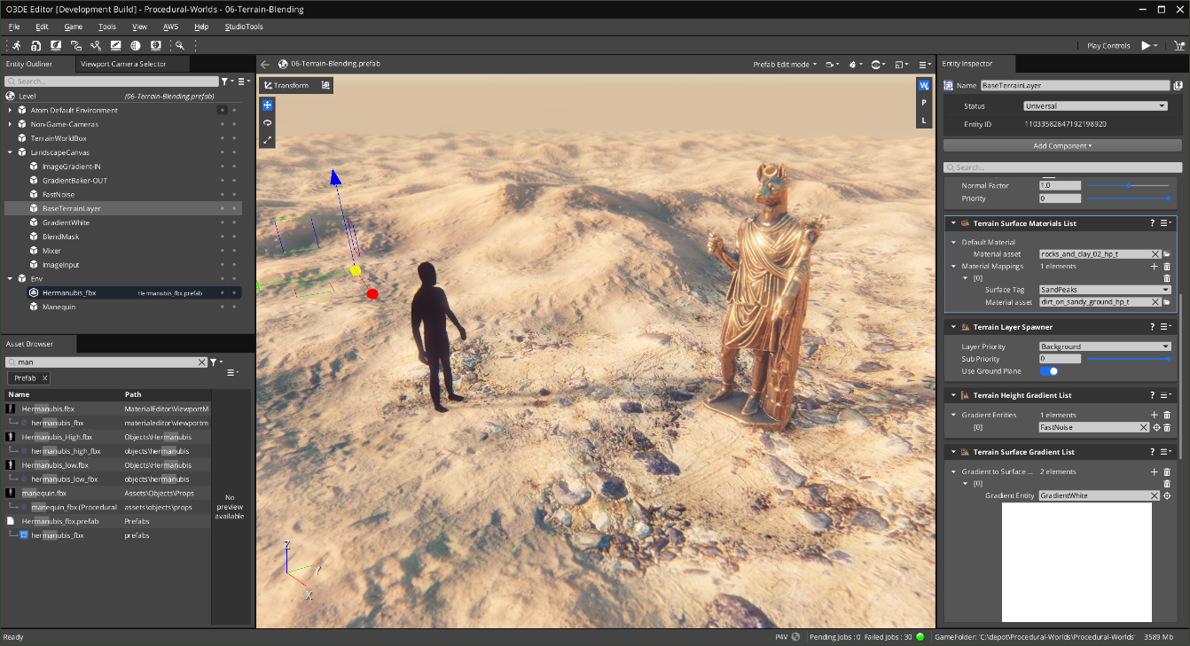
Blend Multiple Materials
With Height Bias

Slide 53
Terrain Material Blending ( Live Demo )
Set up Gradient Mask ( for Rocky Dirt )
Set up Terrain Surface Gradient List
Create a High-Pass TerrainDetailMaterial
Set up Terrain Surface Materials List
Tweak material height biased blending params

Slide 54
Detail Blending
LIVE DEMO … Let’s do this

Slide 55
7. Procedural Biomes
Advanced Concepts at Scale

Slide 56
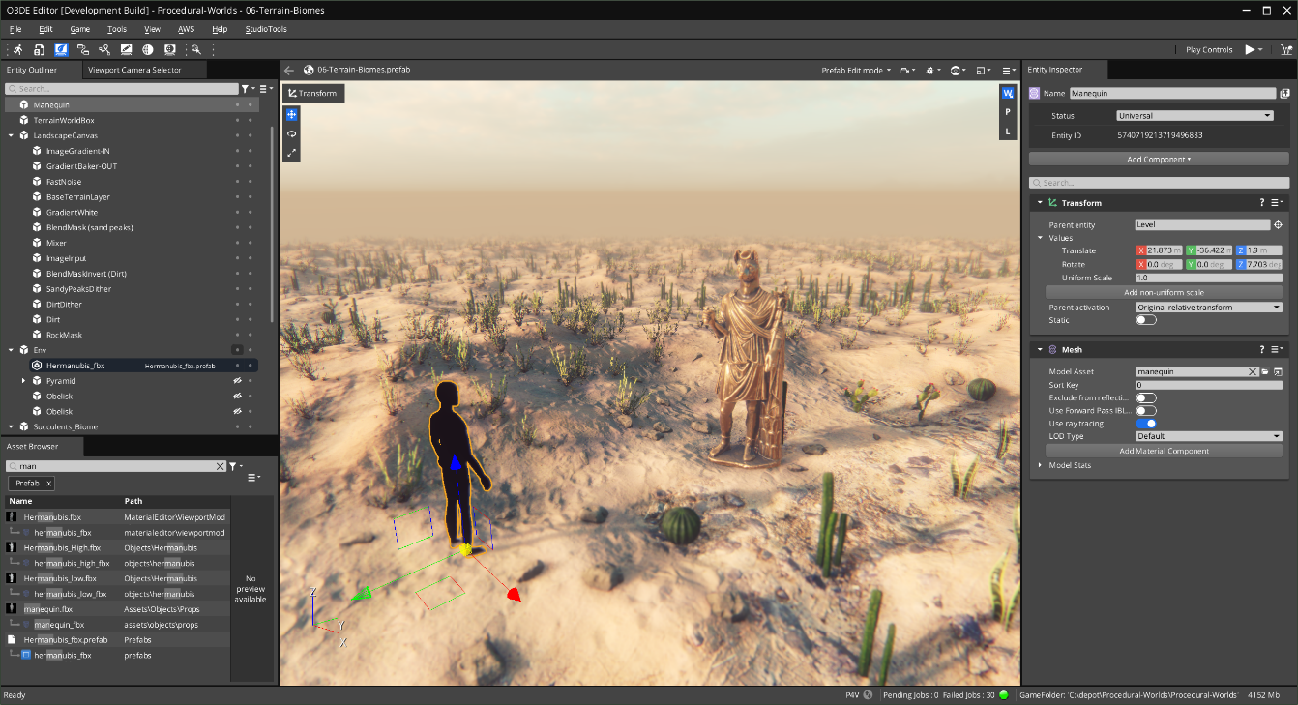

Slide 57
Designing Biomes
LIVE DEMO … Let’s do this

Slide 58
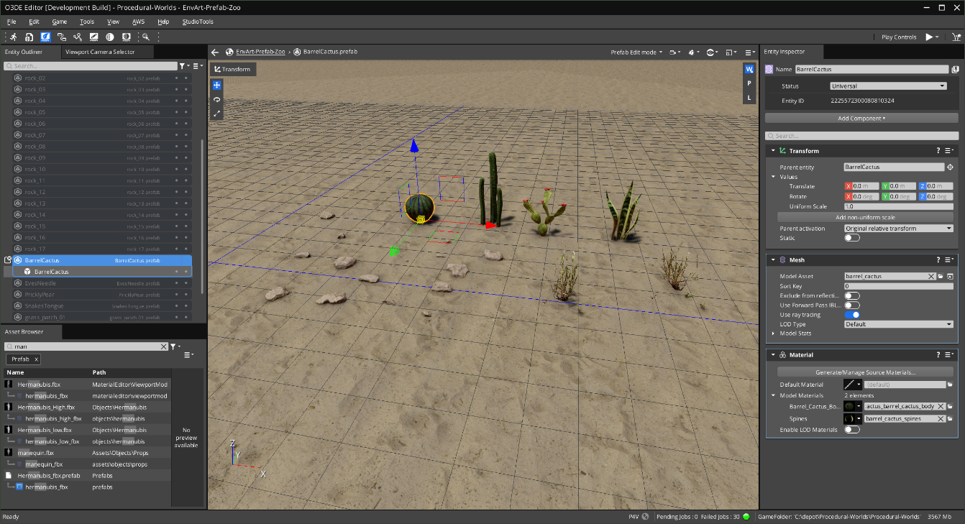

Slide 59
Decorative Object Prefabs
Open level: EnvArt-Prefab-Zoo
Create a Prefab per-object
Mesh Component
Material Component ( assign materials )
Right-click: ‘Create Prefab …’

Slide 60
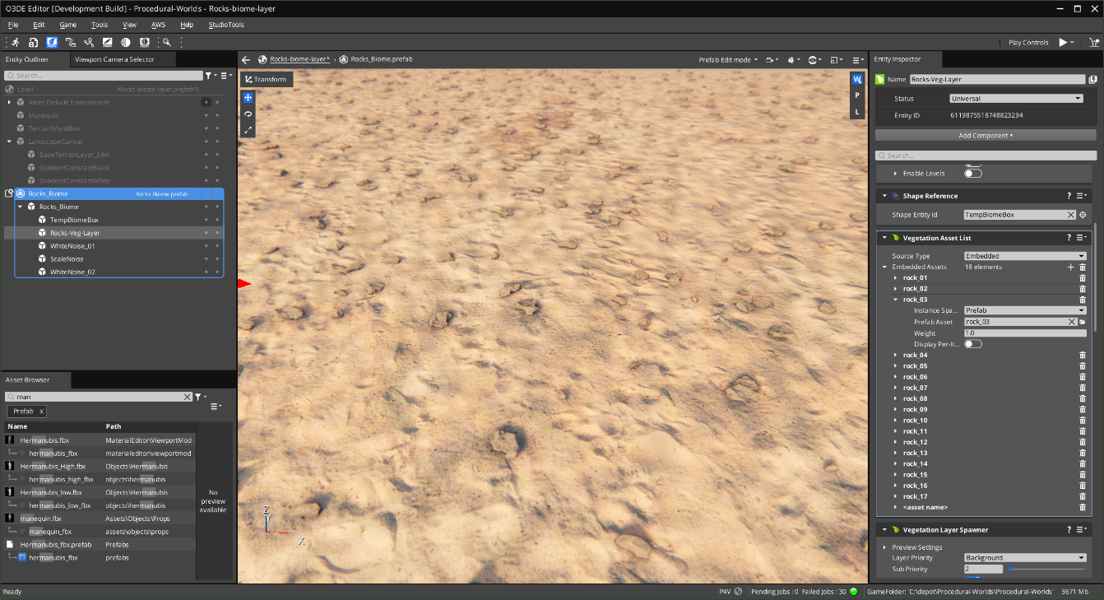

Slide 61
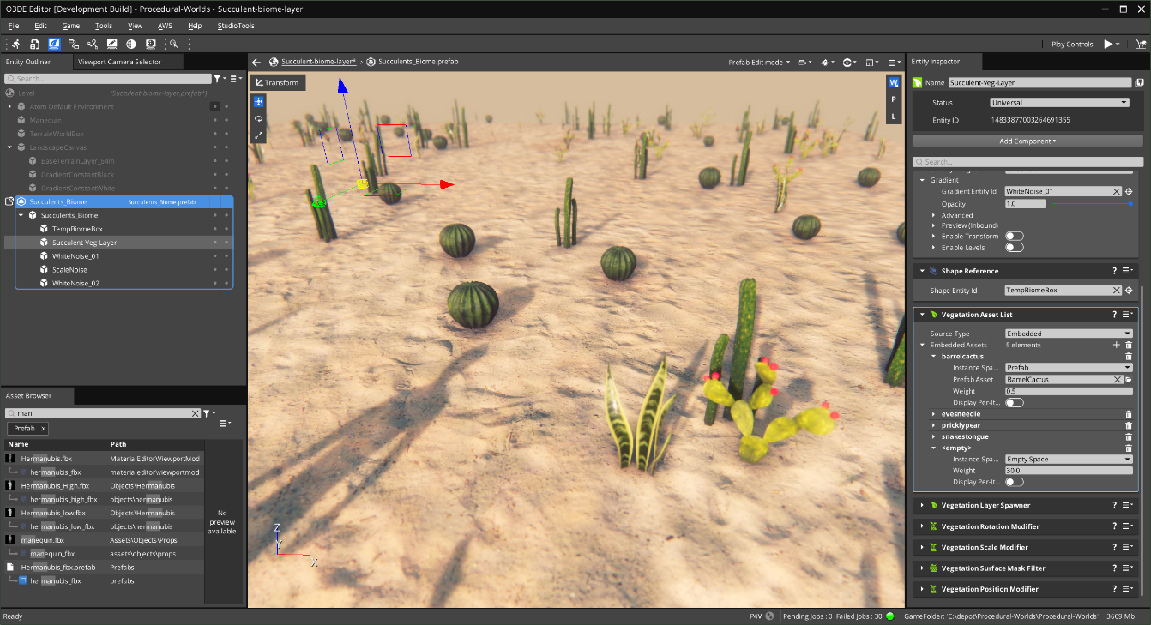

Slide 62
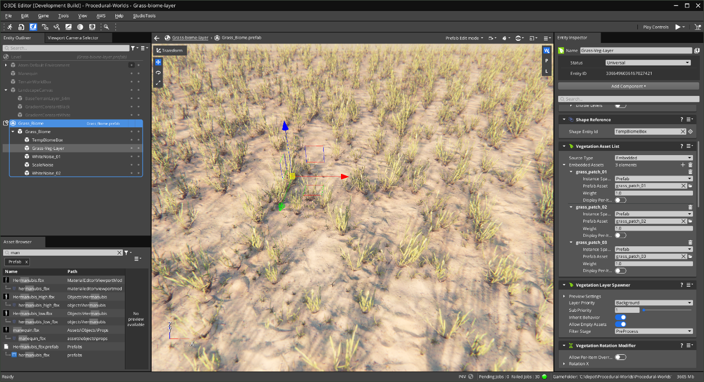

Slide 64
Q and A

Slide 65
CC BY-4.0 Assets used in this Workshop
"Free Realistic Succulent Plants Pack" (Free Realistic Succulent Plants Pack - Download Free 3D model by TreDè (@luigi_disilvestre) [6a22ed2] - Sketchfab) by TreDè is licensed under Creative Commons Attribution (http://creativecommons.org/licenses/by/4.0/).
"Free Rock Assets Pack" (Free Rock Assets Pack - Download Free 3D model by JonhGillessen [227f976] - Sketchfab) by JonhGillessen is licensed under Creative Commons Attribution (http://creativecommons.org/licenses/by/4.0/).
"Grass patches" (Grass patches - Download Free 3D model by DJMaesen (@bumstrum) [6952780] - Sketchfab) by DJMaesen is licensed under Creative Commons Attribution (http://creativecommons.org/licenses/by/4.0/).
"Lowpoly Rocks - 1" (Lowpoly Rocks - 1 - Download Free 3D model by Loïc Norgeot (@norgeotloic) [d9ffac9] - Sketchfab) by Loïc Norgeot is licensed under Creative Commons Attribution (http://creativecommons.org/licenses/by/4.0/).
"Obelisk" (Obelisk - Download Free 3D model by Ankledot [0b4dc3d] - Sketchfab) by Ankledot is licensed under Creative Commons Attribution (http://creativecommons.org/licenses/by/4.0/).
"Pyramid [FREE]" (Pyramid [FREE] - Download Free 3D model by Robin Butler (@StarTrekGuy) [9d95add] - Sketchfab) by Robin Butler is licensed under Creative Commons Attribution (http://creativecommons.org/licenses/by/4.0/).
"Simple grass chunks" (Simple grass chunks - Download Free 3D model by 3dhdscan [eb4f6dc] - Sketchfab) by 3dhdscan is licensed under Creative Commons Attribution (http://creativecommons.org/licenses/by/4.0/).
"Stone obelisk" (Stone obelisk - Download Free 3D model by alexknight [d1652a1] - Sketchfab) by alexknight is licensed under Creative Commons Attribution (http://creativecommons.org/licenses/by/4.0/).

Slide 66
THANK YOU
Twitter: @hogjonny
Discord: HogJonny-AMZN [Amazon]#4953
https://github.com/HogJonny-AMZN

Slide 67
POST CREDITS
This presentation was adapted from the
Spark Business theme (Messala):
Presentation template by SlidesCarnival
Photographs by Unsplash
Illustrations by Pixsellz
Typographies:
https://www.fontsquirrel.com/fonts/poppins
https://www.fontsquirrel.com/fonts/barlow
This template is free to use under Creative Commons Attribution license.
More info on how to use this template at slidescarnival.com/help-use-presentation-template

Slide 68
PRESENTATION TYPOGRAPHY
This presentation uses the following typographies:
Titles: Barlow Bold
Body copy: Barlow Light
Download for free at:
https://www.fontsquirrel.com/fonts/poppins
https://www.fontsquirrel.com/fonts/barlow

